Slide 1
AMC 10 美国数学竞赛
AMC t0 Advanced Class Teacher : Mr. Zheng

Slide 2
0
2
Lesson 2
Topics in Number Theory

Slide 3
Chapter 1
Divisibility

Slide 4
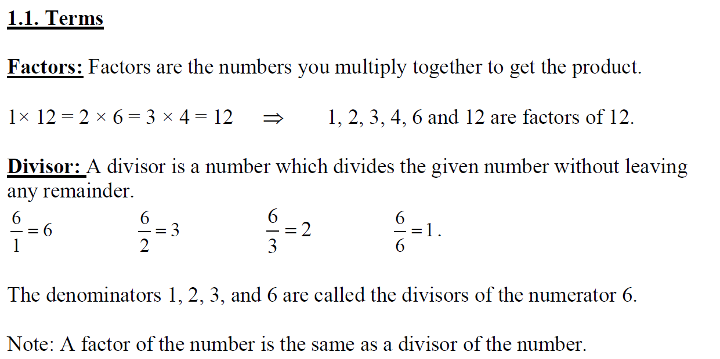
Lead in

Slide 5
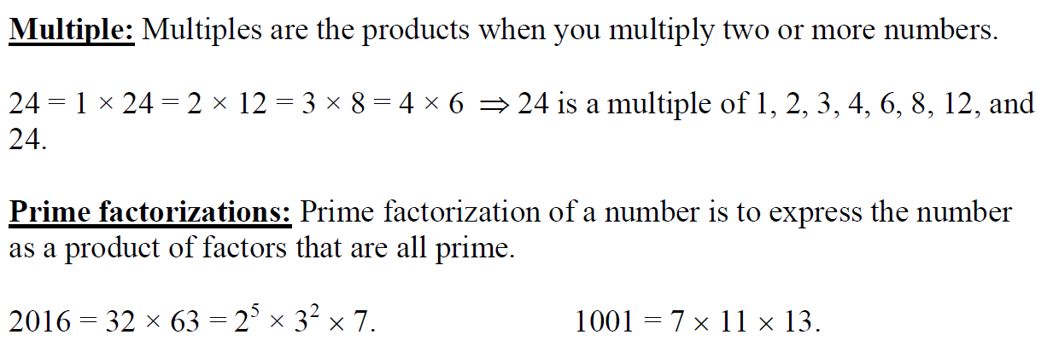
Lead in

Slide 6
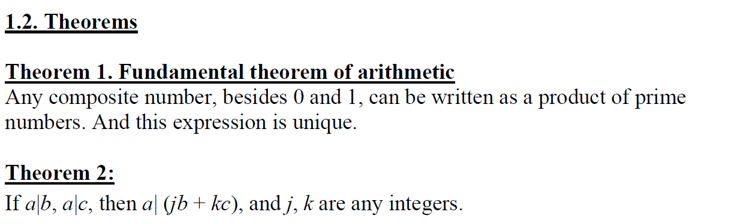
Lead in

Slide 7
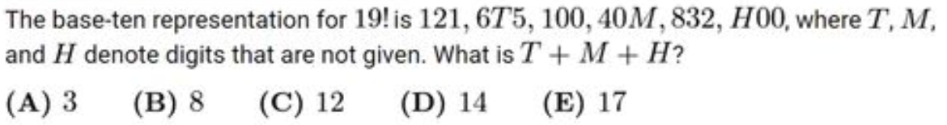
Example

Slide 8
Chapter 2
Number of Factors

Slide 9
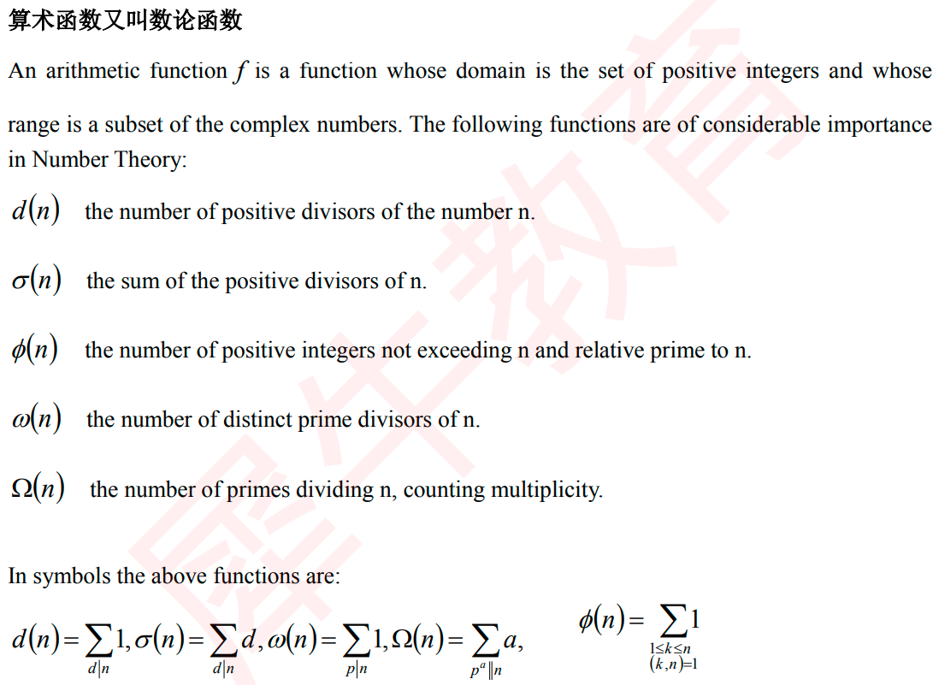
Lead in

Slide 10
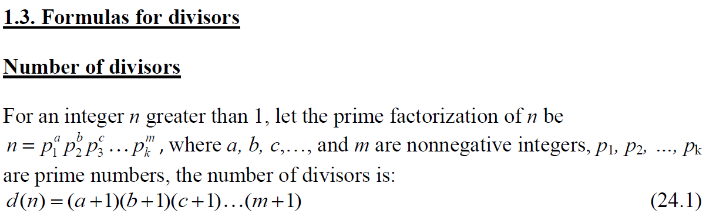
Lead in

Slide 11
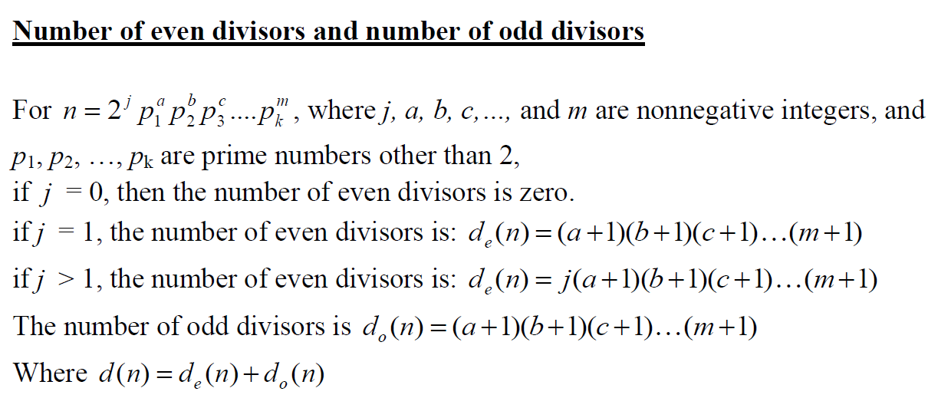
Lead in

Slide 12
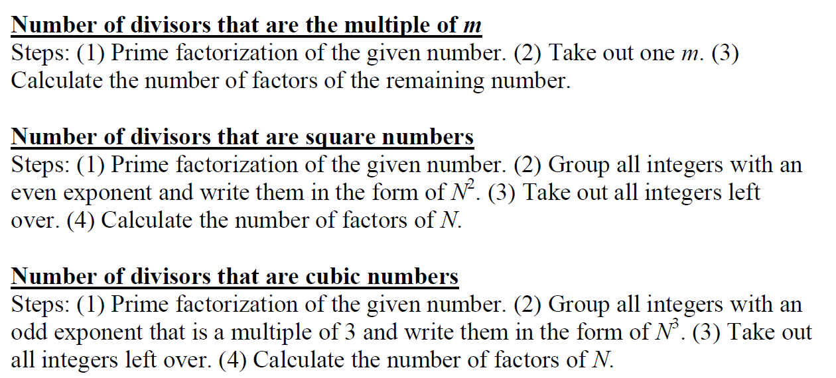
Lead in

Slide 13
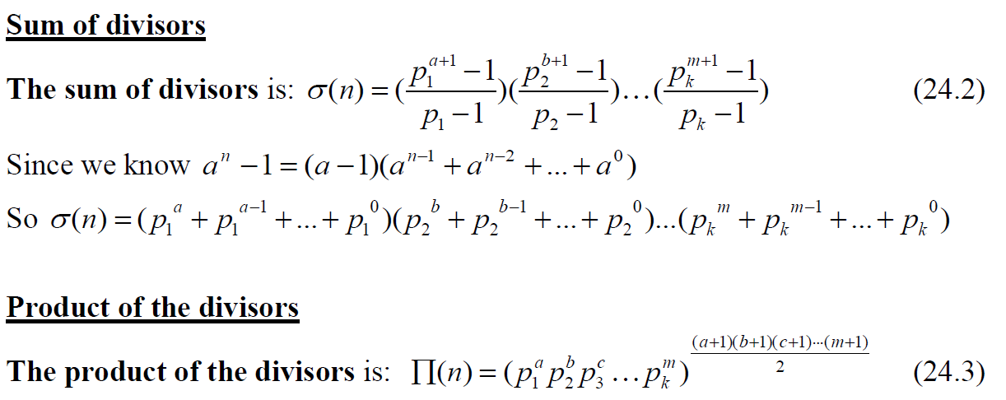
Lead in

Slide 14
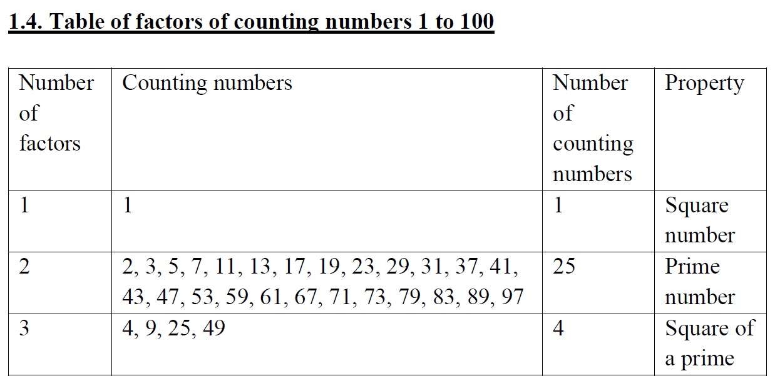
Lead in

Slide 15
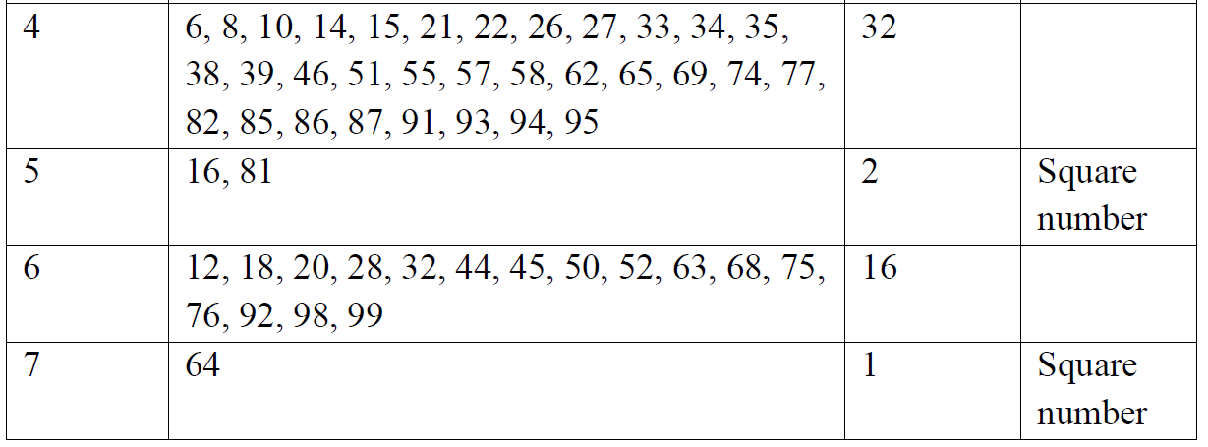
Lead in

Slide 16
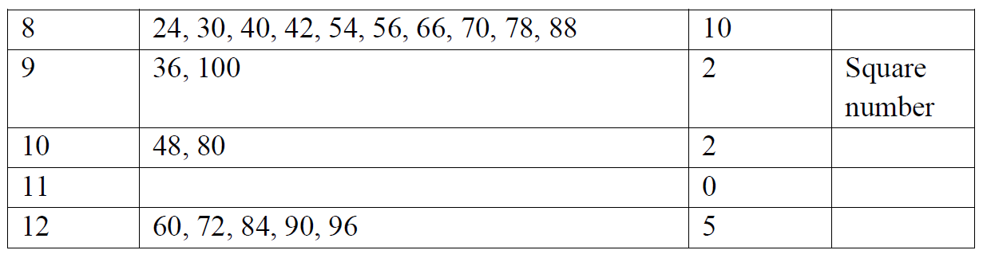
Lead in

Slide 17
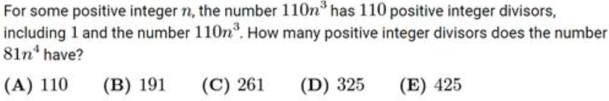
Example

Slide 18
Chapter 3
Square and Cube

Slide 19
Lead in

Slide 20
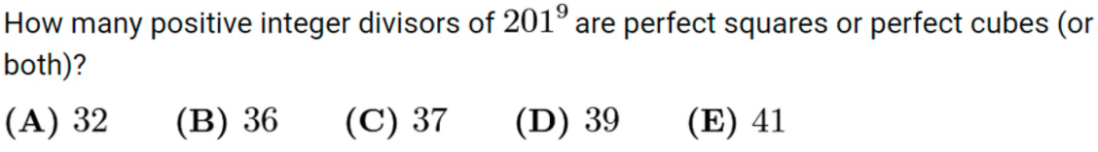
Example

Slide 21
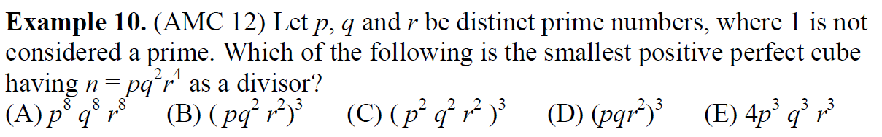
Example

Slide 22
Chapter 4
Nicomachus's Theorem

Slide 23
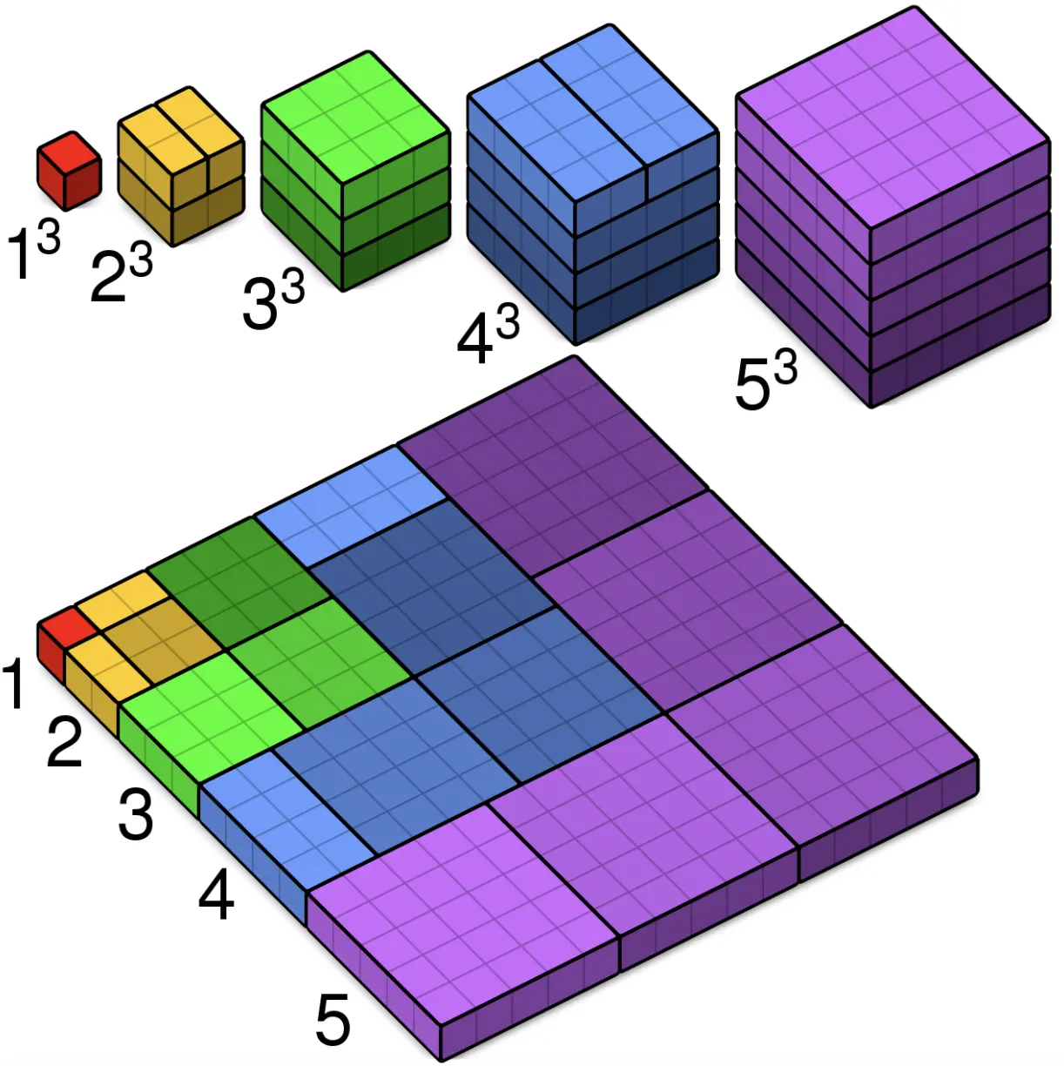
Lead in

Slide 24
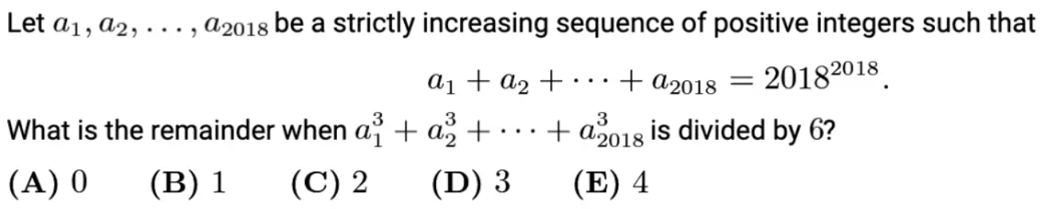
Example

Slide 25
Chapter 5
Properties of Mod

Slide 26
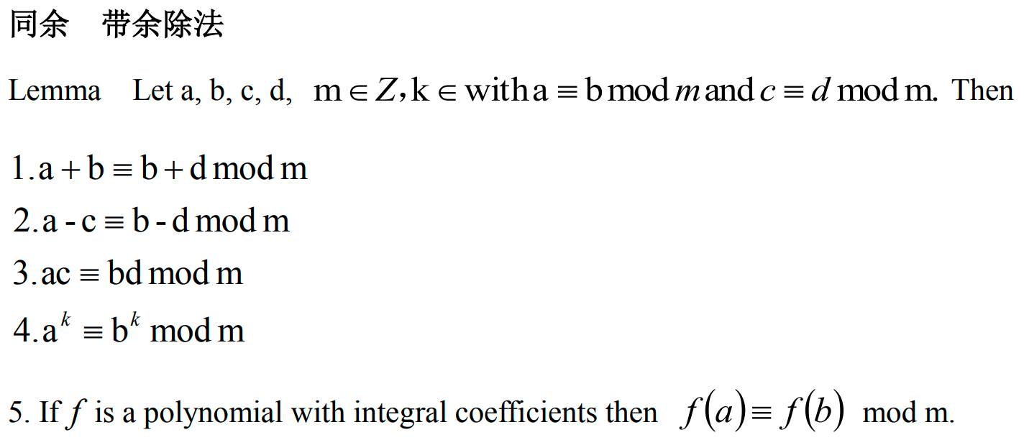
Lead in

Slide 27
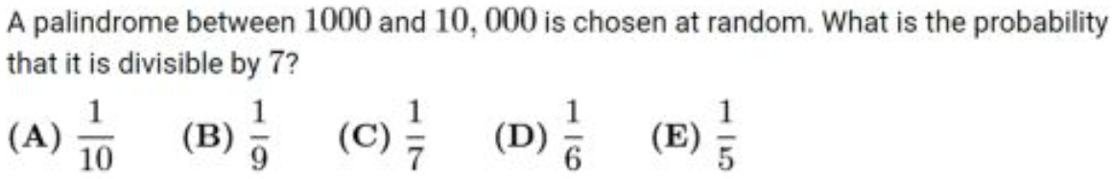
Example

Slide 28
Chapter 6
LCM, GCD and Bézout

Slide 29
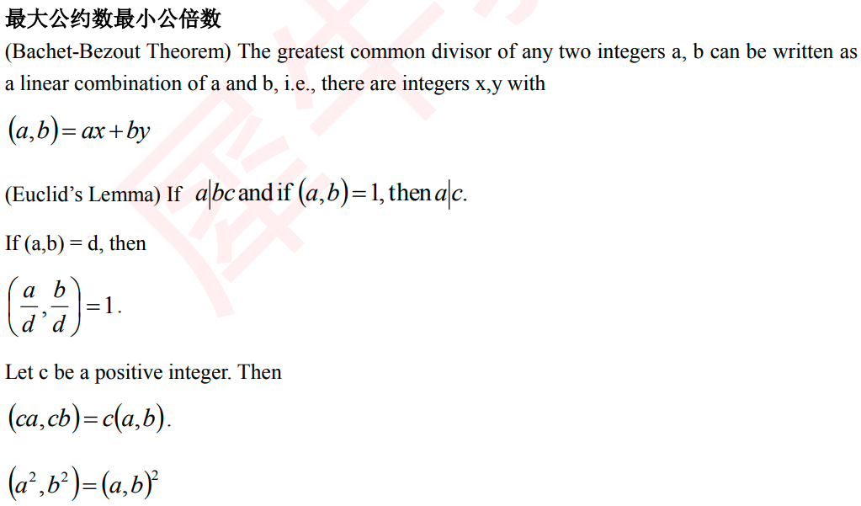
Lead in

Slide 30
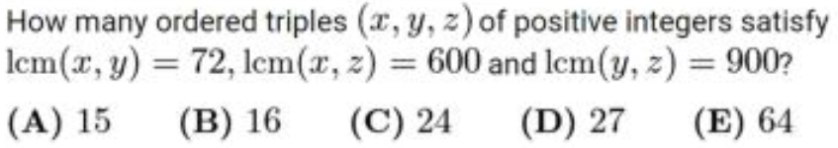
Example

Slide 31
Chapter 7
Euclidean Algorithm

Slide 32
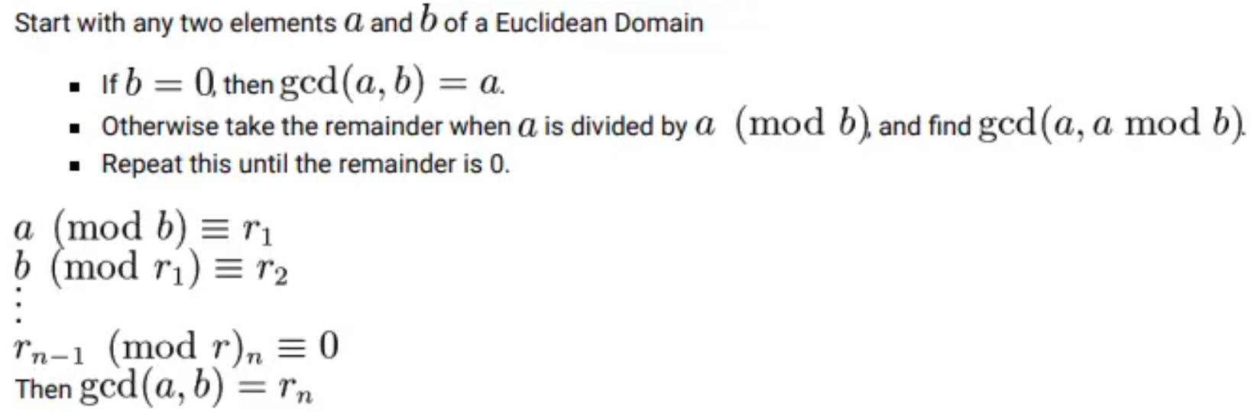
Lead in

Slide 33
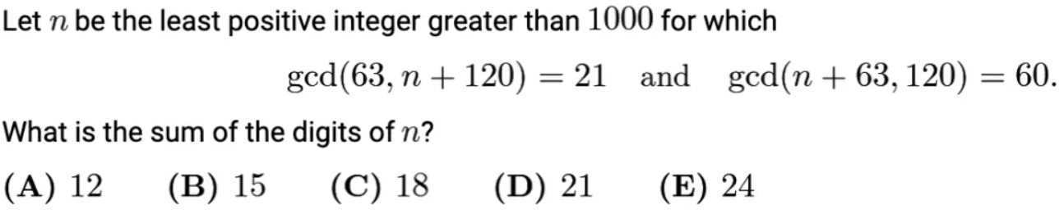
Example

Slide 34
Chapter 8
Chinese Remainder Theorem

Slide 35
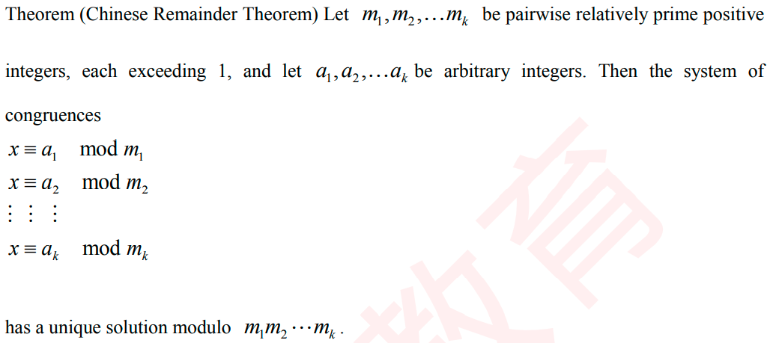
Lead in

Slide 36
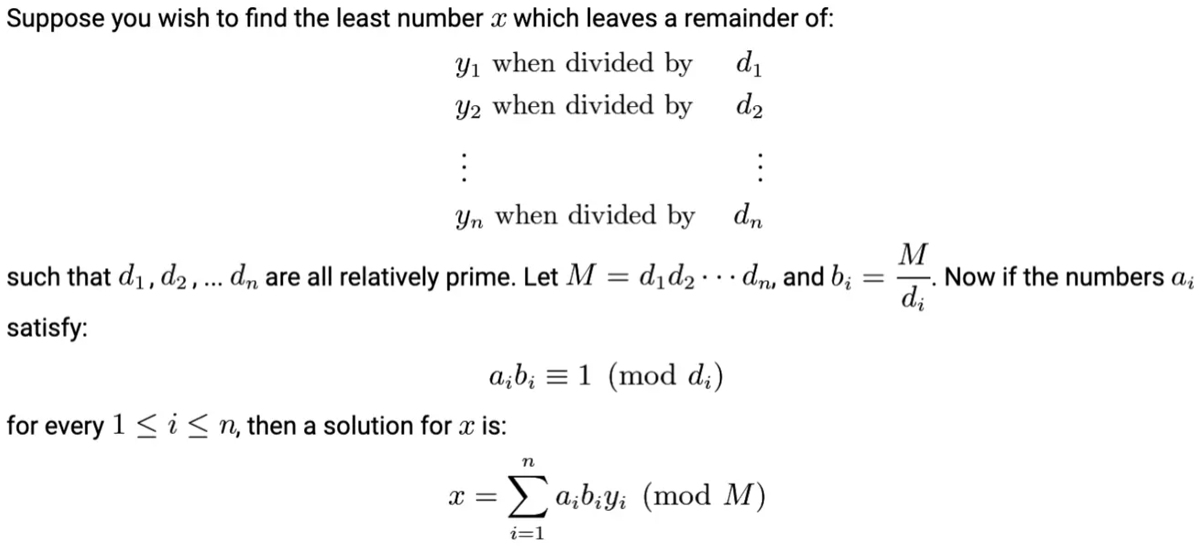
Lead in

Slide 37
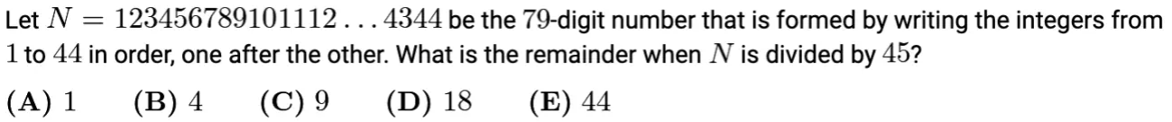
Example

Slide 38
Chapter 9
Fermat's Little Theorem

Slide 39
Lead in

Slide 40
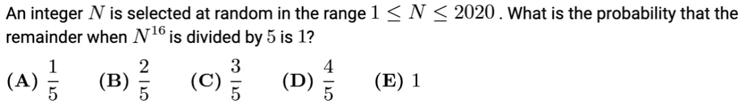
Example

Slide 41
Chapter 10
Wilson's Theorem

Slide 42
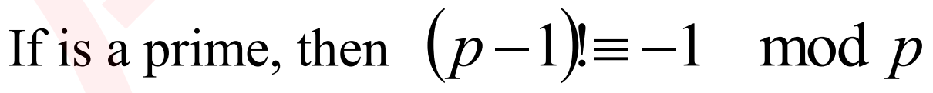
Lead in

Slide 43
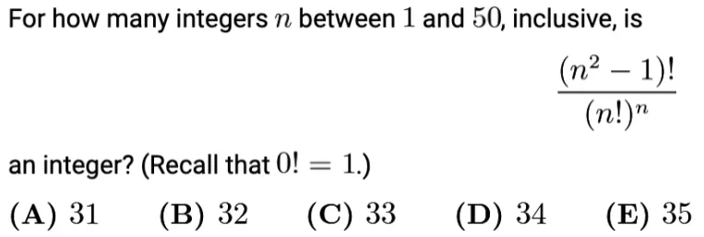
Example

Slide 44
See You Next Time!

